Slide 1

SCC.361: Artificial Intelligence
2024-2025
Week 10 – Lecture 1
Neural Networks Cont.
Hossein Rahmani
Prof. in Computer Vision and Machine Learning
Email: h.rahmani@lancaster.ac.uk

Slide 2
Review: Typical CNN Layers
MLP
Loss function
Convolutional
layer
Non-linearity
layer
Pooling
layer
Input
…

Slide 3
Review: Convolution Layer
0 | 0 | 0 | 1 | 0
2 | 1 | 2 | 2 | 0
2 | 0 | 2 | 0 | 1
1 | 0 | 0 | 0 | 1
1 | 1 | 0 | 2 | 1
Filter $K_{0}(:,:)$
Output $o_{0}(:,:)$
-1 | 0 | 0
1 | 1 | -1
1 | -1 | -1
1 | 0 | 1
-1 | 1 | 1
0 | 0 | -1
Input I$(:,:)$
Element wise multiplication
$$0×−1$$ | $$0×0$$ | $$0×0$$
$$2×1$$ | $$1×1$$ | $$2×−1$$
$$2×1$$ | $$0×−1$$ | $$2×−1$$
$$0$$ | $$0$$ | $$0$$
$$2$$ | $$1$$ | $$−2$$
$$2$$ | $$0$$ | $$−2$$
Sum
$$0+0+0+2+1+\left(−2\right)+2+0+\left(−2\right)=1$$

Slide 4
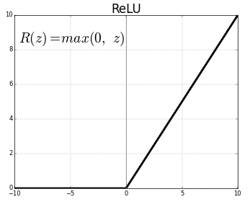
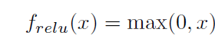
Review: Activation Functions
Rectifier Linear Unit (ReLU)
ReLU is a simple activation function
Quick computation
Most popular activation function for deep networks
Avoids saturation issues and makes learning faster
Variants:
Noisy ReLU
Leaky ReLU
Parametric Linear Units
Randomized Leaky Rectier Linear Unit
Exponential Linear Units
Notes:
ReLU is a simple activation function which is of special practical importance because of it's quick computation.
Most popular activation function for deep networks as of 2015, avoids saturation issues and makes learning faster
A ReLU function maps the input to a 0 if it is negative and keeps its value unchanged if it is positive.
The popularity and effectiveness of ReLU has lead to a number of its variants including:

Slide 5
Review: Pooling Layer
Replaces the output of the network at a certain location with a summary statistic of the nearby outputs.
Reduces computation for upper layers
Non-linear down-sampling
Provides translation invariance
Useful property, if we care more about whether some feature is present than exactly where it is, thus adds robustness to position
Variants:
Max pooling (popular): reports the maximum output within a rectangular neighborhood
Average pooling: reports the average output
L2 norm of neighbourhood
Notes:
The pooling function replaces the output of the network at a certain location with a summary statistic of the nearby outputs.
Reduces computation for upper layers by reporting summary statistics (only with stride > 1)
Non-linear down-sampling to simplify the information in output from convolutional layer.
Pooling helps to make the representation become approximately invariant to small translations of the input. Invariance to translation means that if we translate the input by a small amount, the values of most of the pooled outputs do not change.

Slide 6
Review: Pooling Layer
The maximum activation is chosen from the selected block of values
Similar to the convolution layer, we need to specify the size of pooled region and the stride.
If the size of pooled region is given by $f×f$, with a stride $s$, the size of the output feature map can be given by:
Stride 1, size of pooled region $3×3$
3 | 0 | 0 | 1 | 0
2 | 8 | 5 | 2 | 0
2 | 0 | 2 | 0 | 1
6 | 0 | 0 | 0 | 1
1 | 1 | 0 | 5 | 1
8 | 8 | 5
8 | 8 | 5
6 | 5 | 5
Input features map
Output after Max-Pooling

Slide 7
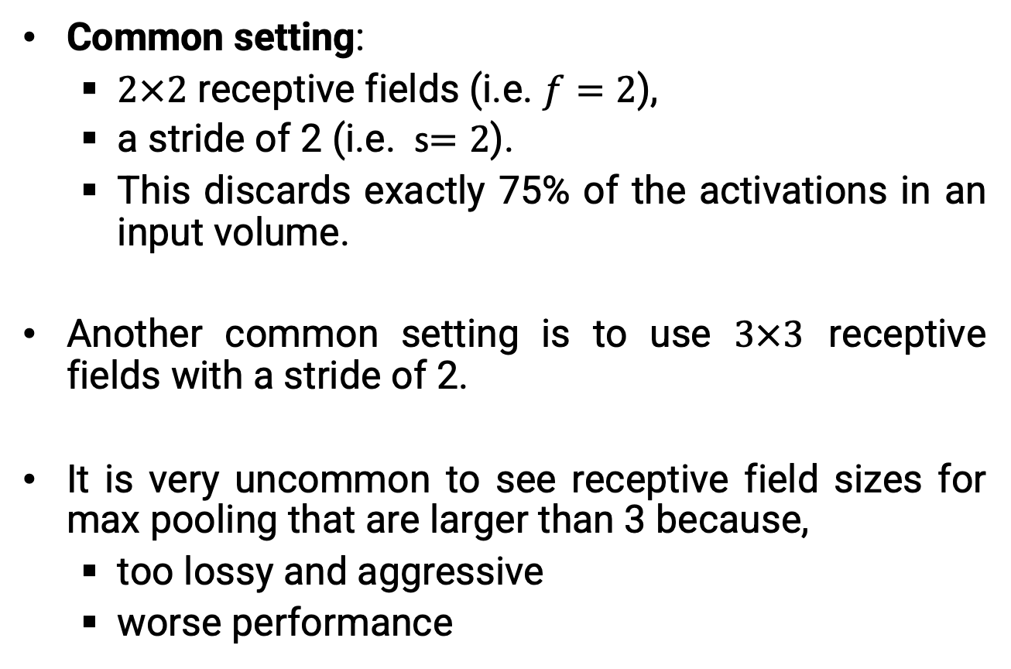
Review: Pooling Layer
Common setting:
$2×2$ receptive fields (i.e. $f=2$),
a stride of 2 (i.e. s$=2$).
This discards exactly 75% of the activations in an input volume.
Another common setting is to use $3×3$ receptive fields with a stride of 2.
It is very uncommon to see receptive field sizes for max pooling that are larger than 3 because,
too lossy and aggressive
worse performance
Notes:
The most common setting is to use max-pooling with 2x2 receptive fields (i.e. F=2), and with a stride of 2 (i.e. S=2). Note that this discards exactly 75% of the activations in an input volume (due to downsampling by 2 in both width and height).
Another slightly less common setting is to use 3x3 receptive fields with a stride of 2.
It is very uncommon to see receptive field sizes for max pooling that are larger than 3 because the pooling is then too lossy and aggressive. This usually leads to worse performance.

Slide 8

VGGNET
(Example)
Number of
filters/channels
Notes:
Convolution with a single kernel can only extract one kind of feature, albeit at many spatial locations. Usually we want each layer of our network to extract many kinds of features, at many locations.

Slide 9
Multiple Filters-Multiple Outputs
0 | 0 | 0 | 1 | 0
2 | 1 | 2 | 2 | 0
2 | 0 | 2 | 0 | 1
1 | 0 | 0 | 0 | 1
1 | 1 | 0 | 2 | 1
Filter $K_{0}(:,:,1)$
Output $o_{0}(:,:,1)$
-1 | 0 | 0
1 | 1 | -1
1 | -1 | -1
1 | 0 | 1
-1 | 1 | 1
0 | 0 | -1
Input $I(:,:,1)$
2 | 1 | 0 | 1 | 2
0 | 1 | 0 | 1 | 1
1 | 2 | 0 | 0 | 2
1 | 1 | 1 | 2 | 1
2 | 0 | 0 | 0 | 2
Filter $K_{0}(:,:,2)$
1 | 0 | 1
-1 | 1 | 1
0 | 0 | -1
Input $I(:,:,2)$
2 | 1 | 0 | 1 | 2
0 | 1 | 0 | 1 | 1
1 | 2 | 0 | 0 | 2
1 | 1 | 1 | 2 | 1
2 | 0 | 0 | 0 | 2
Filter $K_{0}(:,:,3)$
-1 | -1 | -1
1 | 0 | -1
-1 | -1 | 1
Input $I(:,:,3)$

Slide 10
Multiple Filters-Multiple Outputs
0 | 0 | 0 | 1 | 0
2 | 1 | 2 | 2 | 0
2 | 0 | 2 | 0 | 1
1 | 0 | 0 | 0 | 1
1 | 1 | 0 | 2 | 1
Filter $K_{1}(:,:,1)$
Output $o_{0}(:,:,1)$
1 | 0 | 0
-1 | -1 | -1
1 | 0 | 1
1 | 0 | 1
-1 | 1 | 1
0 | 0 | -1
Input $I(:,:,1)$
Output $o_{0}(:,:,2)$
2 | 1 | 0 | 1 | 2
0 | 1 | 0 | 1 | 1
1 | 2 | 0 | 0 | 2
1 | 1 | 1 | 2 | 1
2 | 0 | 0 | 0 | 2
Filter $K_{1}(:,:,2)$
-1 | 0 | 1
1 | -1 | 1
1 | 0 | 1
1 | -1 | -1
1 | 1 | 0
1 | -1 | -1
Input $I(:,:,2)$
2 | 1 | 0 | 1 | 2
0 | 1 | 0 | 1 | 1
1 | 2 | 0 | 0 | 2
1 | 1 | 1 | 2 | 1
2 | 0 | 0 | 0 | 2
Filter $K_{1}(:,:,3)$
-1 | 1 | -1
-1 | -1 | -1
-1 | 1 | -1
Input $I(:,:,3)$

Slide 11
Multiple Filters-Multiple Outputs
0 | 0 | 0 | 1 | 0
2 | 1 | 2 | 2 | 0
2 | 0 | 2 | 0 | 1
1 | 0 | 0 | 0 | 1
1 | 1 | 0 | 2 | 1
Filter $K_{2}(:,:,1)$
Output $o_{0}(:,:,1)$
0 | -1 | 0
-1 | 0 | 0
-1 | 0 | 1
1 | 0 | 1
-1 | 1 | 1
0 | 0 | -1
Input $I(:,:,1)$
Output $o_{0}(:,:,2)$
2 | 1 | 0 | 1 | 2
0 | 1 | 0 | 1 | 1
1 | 2 | 0 | 0 | 2
1 | 1 | 1 | 2 | 1
2 | 0 | 0 | 0 | 2
Filter $K_{2}(:,:,2)$
-1 | 0 | 1
1 | -1 | 1
1 | 0 | 1
1 | -1 | -1
0 | -1 | 0
-1 | 0 | -1
Input $I(:,:,2)$
Output $o_{0}(:,:,3)$
1 | 0 | 1
-1 | 1 | 1
0 | 0 | -1
2 | 1 | 0 | 1 | 2
0 | 1 | 0 | 1 | 1
1 | 2 | 0 | 0 | 2
1 | 1 | 1 | 2 | 1
2 | 0 | 0 | 0 | 2
Filter $K_{2}(:,:,3)$
0 | 1 | -1
1 | 0 | -1
0 | 1 | -1
Input $I(:,:,3)$
…
E.g. 3 filters 3 outputs

Slide 12
VGGNET
(Example)
Number of
filters/channels
Notes:
Convolution with a single kernel can only extract one kind of feature, albeit at many spatial locations. Usually we want each layer of our network to extract many kinds of features, at many locations.

Slide 13
Outline
Convolutional Neural Networks (CNN)
Convolution Layer
Activation Function
Pooling Layer
Transposed Convolution (Deconv)
Un-pooling layer

Slide 14
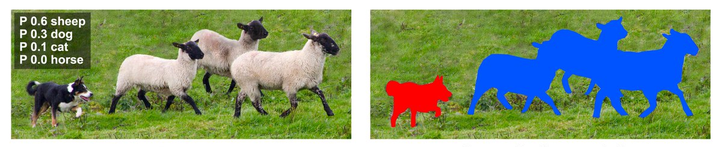
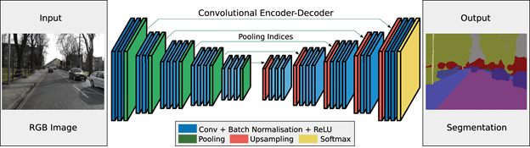
Semantic Segmentation

Slide 15
Outline
Convolutional Neural Networks (CNN)
Convolution Layer
Activation Function
Pooling Layer
Transposed Convolution (Deconv)
Un-pooling layer

Slide 16
Transposed Convolution
The CNN layers we have seen so far, such as convolutional layers and pooling layers, typically reduce (downsample) the spatial dimensions (height and width) of the input or keep them unchanged.
In semantic segmentation that classifies at pixel-level, it will be convenient if the spatial dimensions of the input and output are the same.

Slide 17
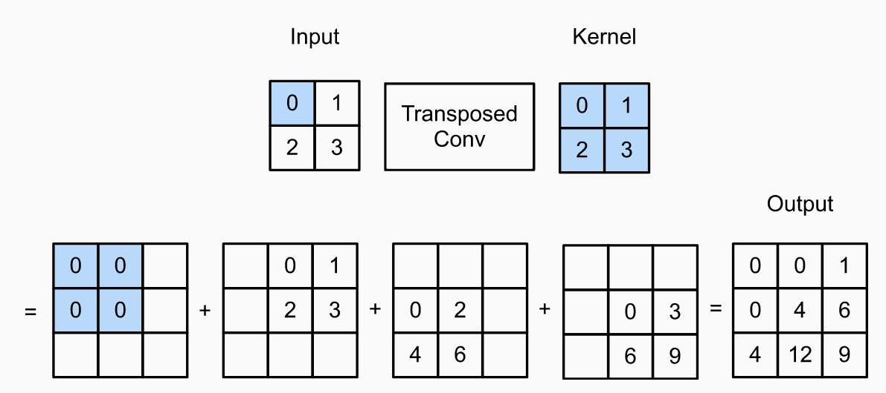
Transposed Convolution (Example)
Transposed convolution with a 2×2 kernel is computed for a 2×2 input.

Slide 18
Outline
Convolutional Neural Networks (CNN)
Convolution Layer
Activation Function
Pooling Layer
Transposed Convolution (Deconv)
Un-pooling layer

Slide 19
Un-Pooling Layer
Max-unpooling is an upsampling procedure
Max pooling is a non-invertable operation, instead we obtain an approximation
Approaches include:
Nearest-Neighbor
Bed of Nails
Max Unpooling

Slide 20
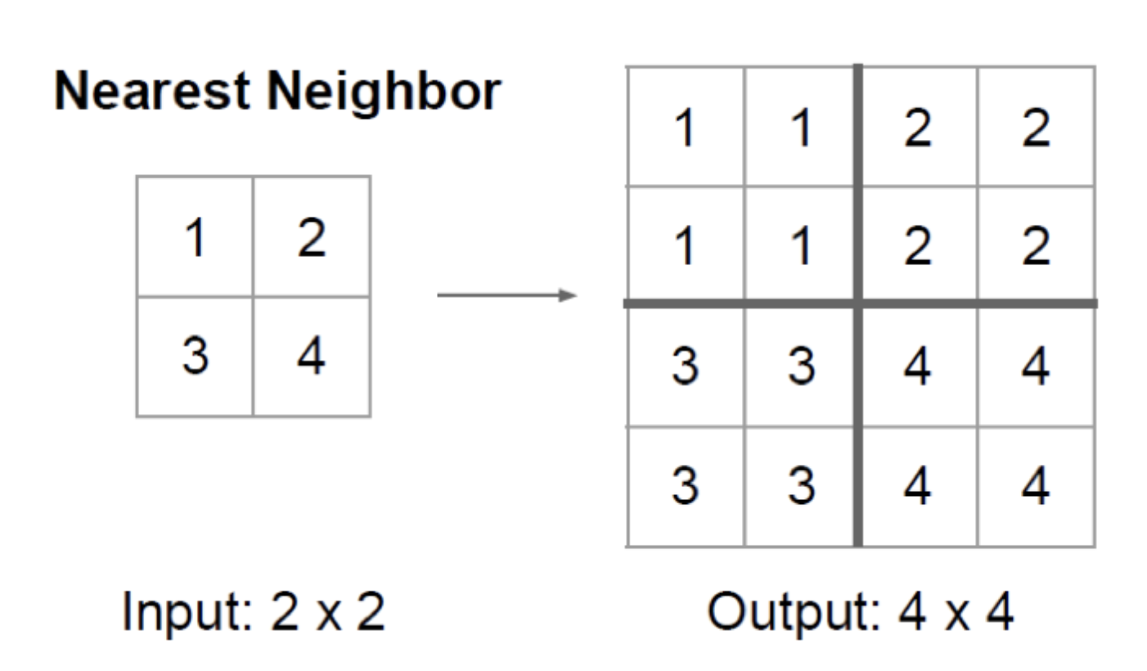
Un-Pooling Layer
(Nearest-Neighbor)
Although its simplicity, the problem of this approach is that the output structure becomes blocky as all pixels in each subregion have the same value.

Slide 21
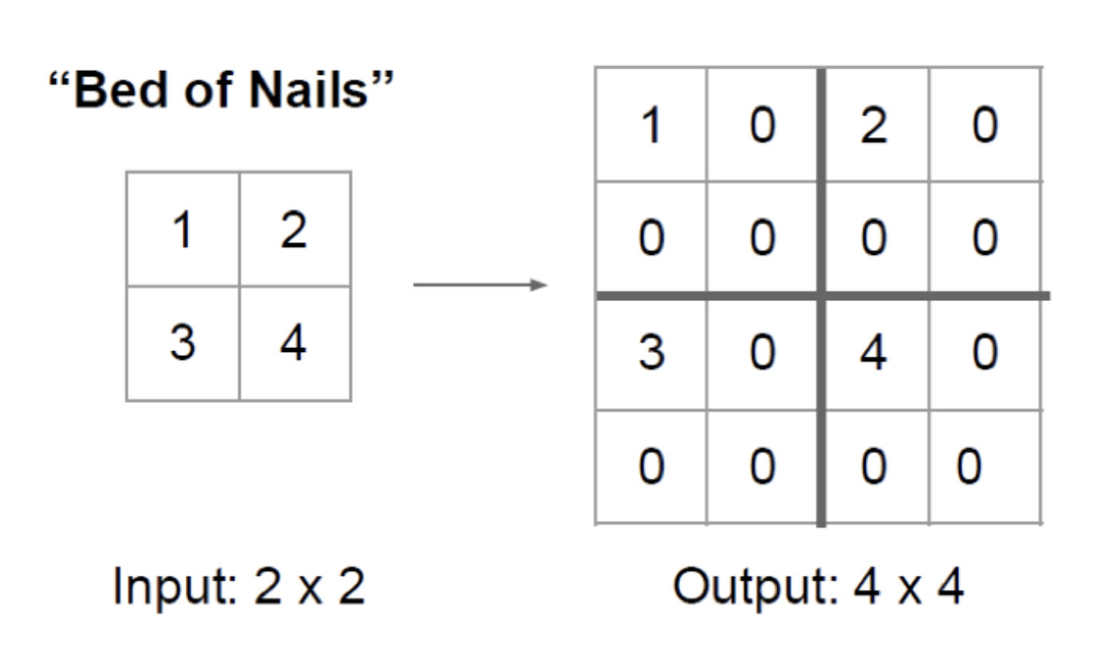
Un-Pooling Layer
(Bed of Nails)
By doing so, it achieves the fine-grained output structure. However, the upsampled elements always have a fixed location, which is the upper-left corner

Slide 22
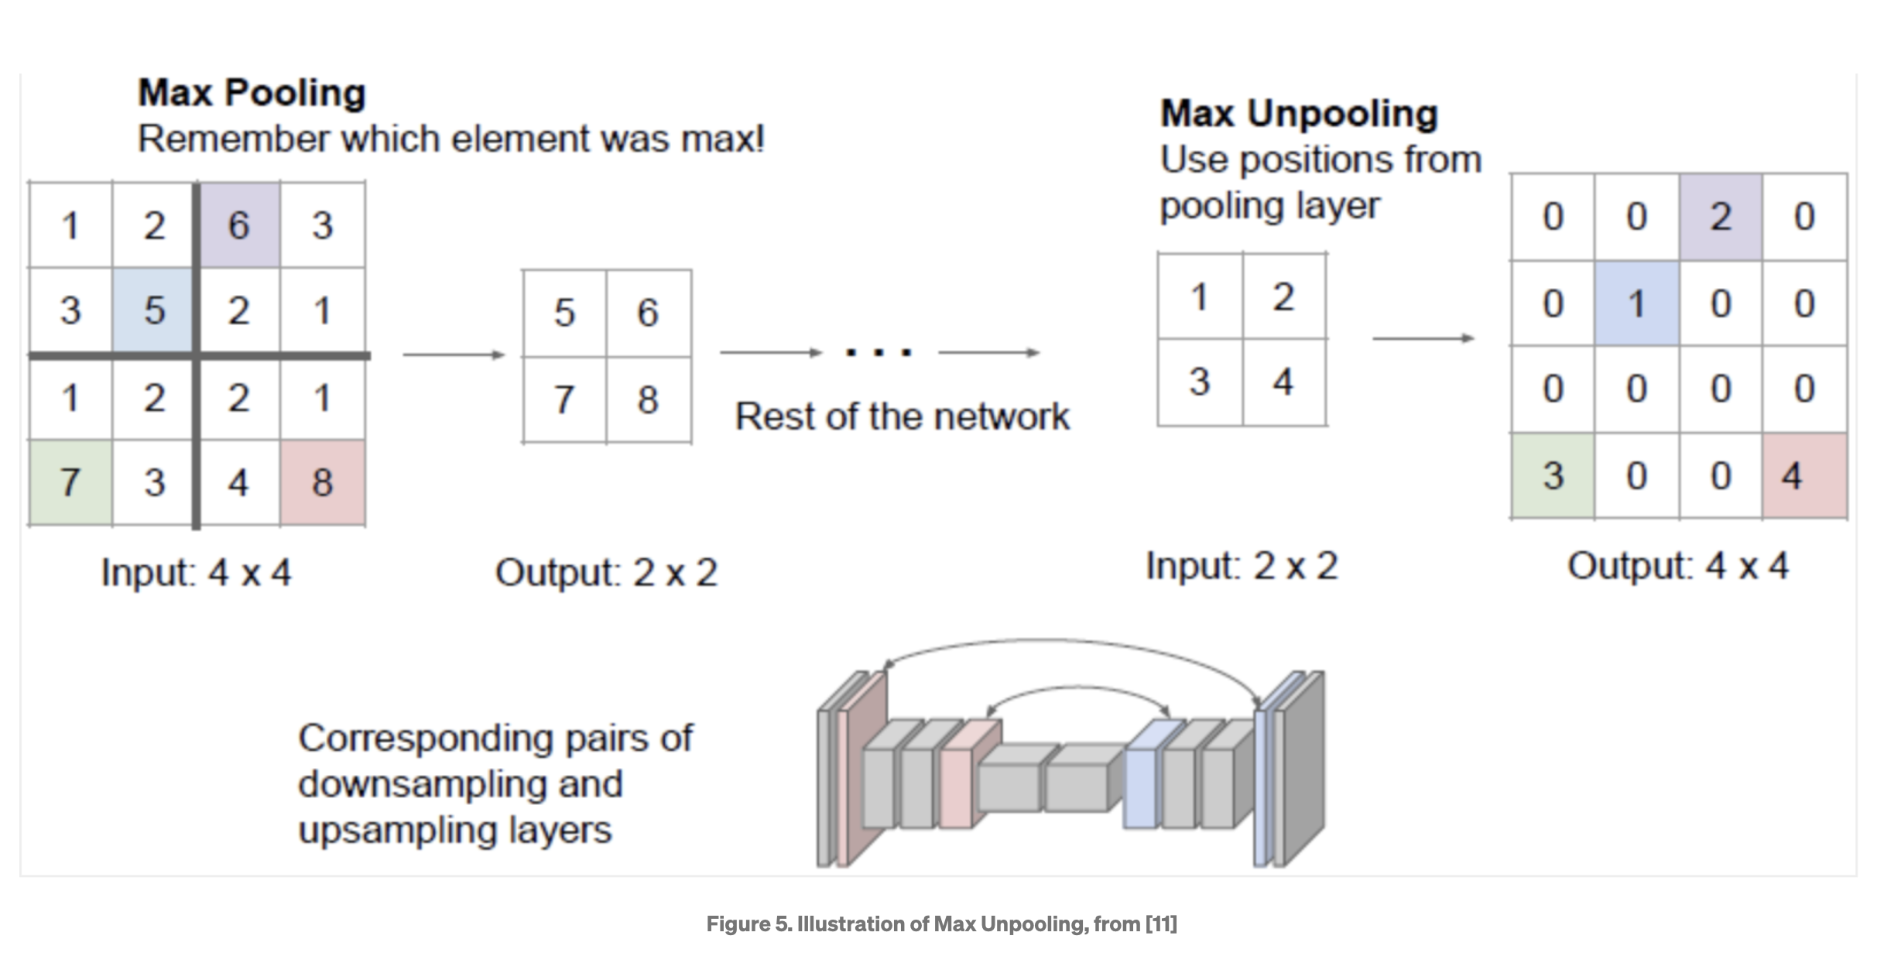
Un-Pooling Layer
(Max Unpooling)

Slide 24
Training Neural Networks
This process tunes the parameters such that the input space is correctly mapped to the output space.
The current estimate of the output variables is matched with the desired output.
This matching function (e.g. Cross Entropy) serves as an objective function during the MLP training and it is usually called the loss function or the error function.
Neural Network training process involves the optimization of the model parameters such that the loss function is minimized.
The optimization of such non-linear models is a hard task.
The gradient based methods come as a natural choice

Slide 25
Training Neural Networks
The combination of weights which minimizes the error function (e.g. cross-entropy) is considered to be a solution of the learning problem.
Intuition: Gradient tells us direction of greatest increase; negative gradient gives us direction of greatest decrease.
Since this method requires computation of the gradient of the error function at each iteration step, we must guarantee the continuity and differentiability of the error function.

Slide 26
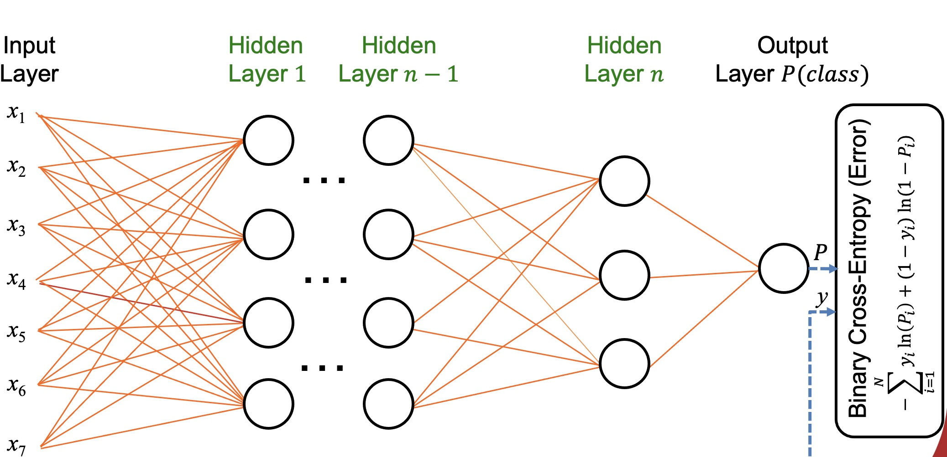
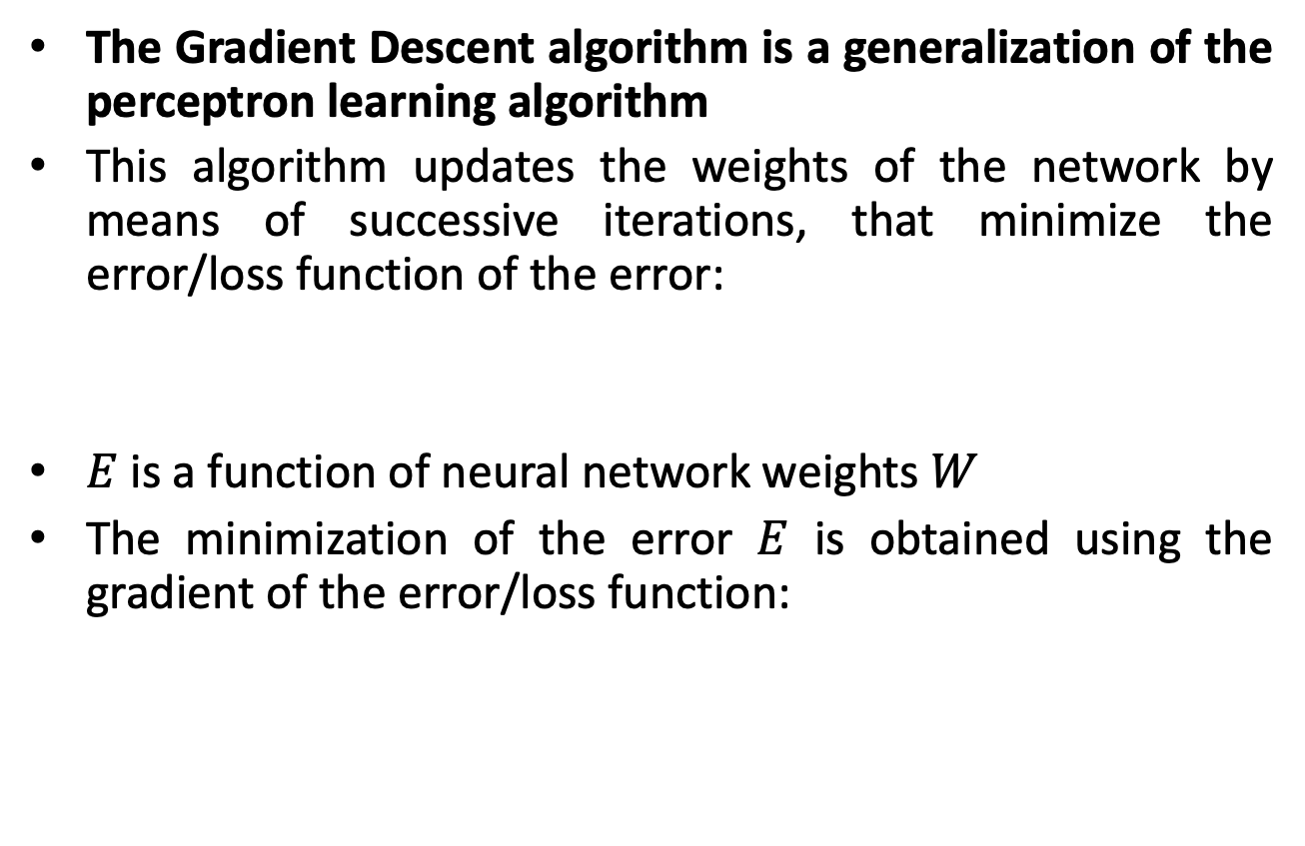
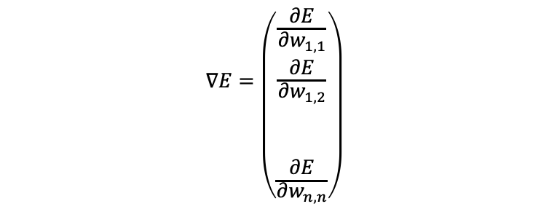
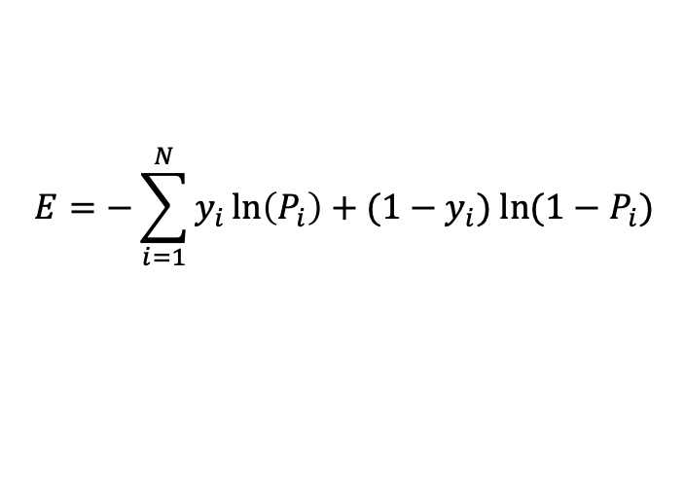
Gradient Descent Algorithm
The Gradient Descent algorithm is a generalization of the perceptron learning algorithm
This algorithm updates the weights of the network by means of successive iterations, that minimize the error/loss function of the error:
$E$ is a function of neural network weights $W$
The minimization of the error $E$ is obtained using the gradient of the error/loss function:
$$E=−\sum_{i=1}^{N}{y_{i}\ln\left(P_{i}\right)+{(1−y}_{i}) ln⁡(1−P_{i})}$$
$$∇E=\left({\frac{∂E}{∂w_{1,1}} \atop \begin{aligned}\frac{∂E}{∂w_{1,2}} \\ \\ \\ \frac{∂E}{∂w_{n,n}}\end{aligned}}\right)$$

Slide 27
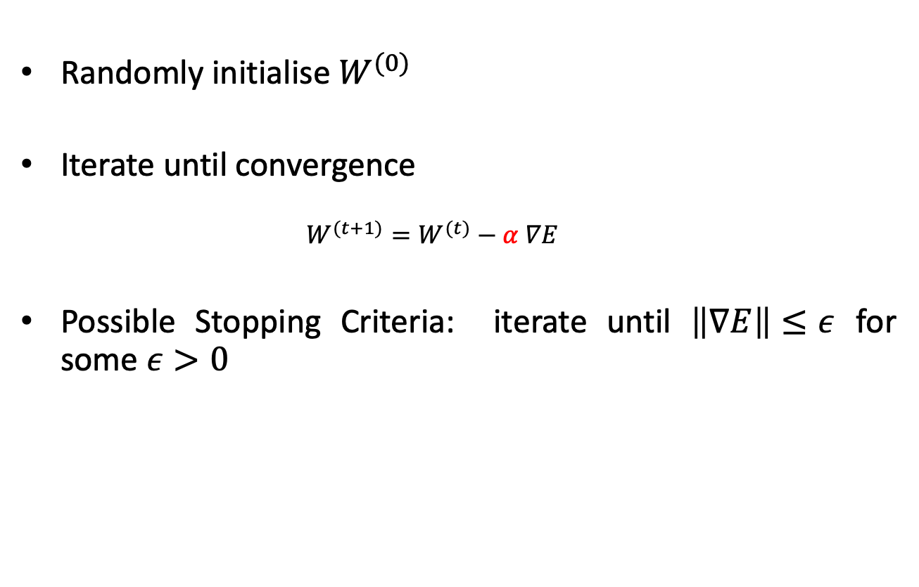
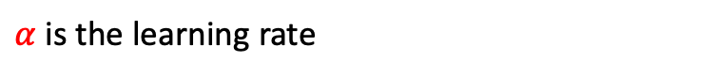
Gradient Descent Algorithm
Randomly initialise $W^{(0)}$
Iterate until convergence
$$W^{(t+1)}=W^{(t)}−α ∇E$$
Possible Stopping Criteria: iterate until $\left\|∇E\right\|≤ε$ for some $ε>0$
$α$ is the learning rate

Slide 28
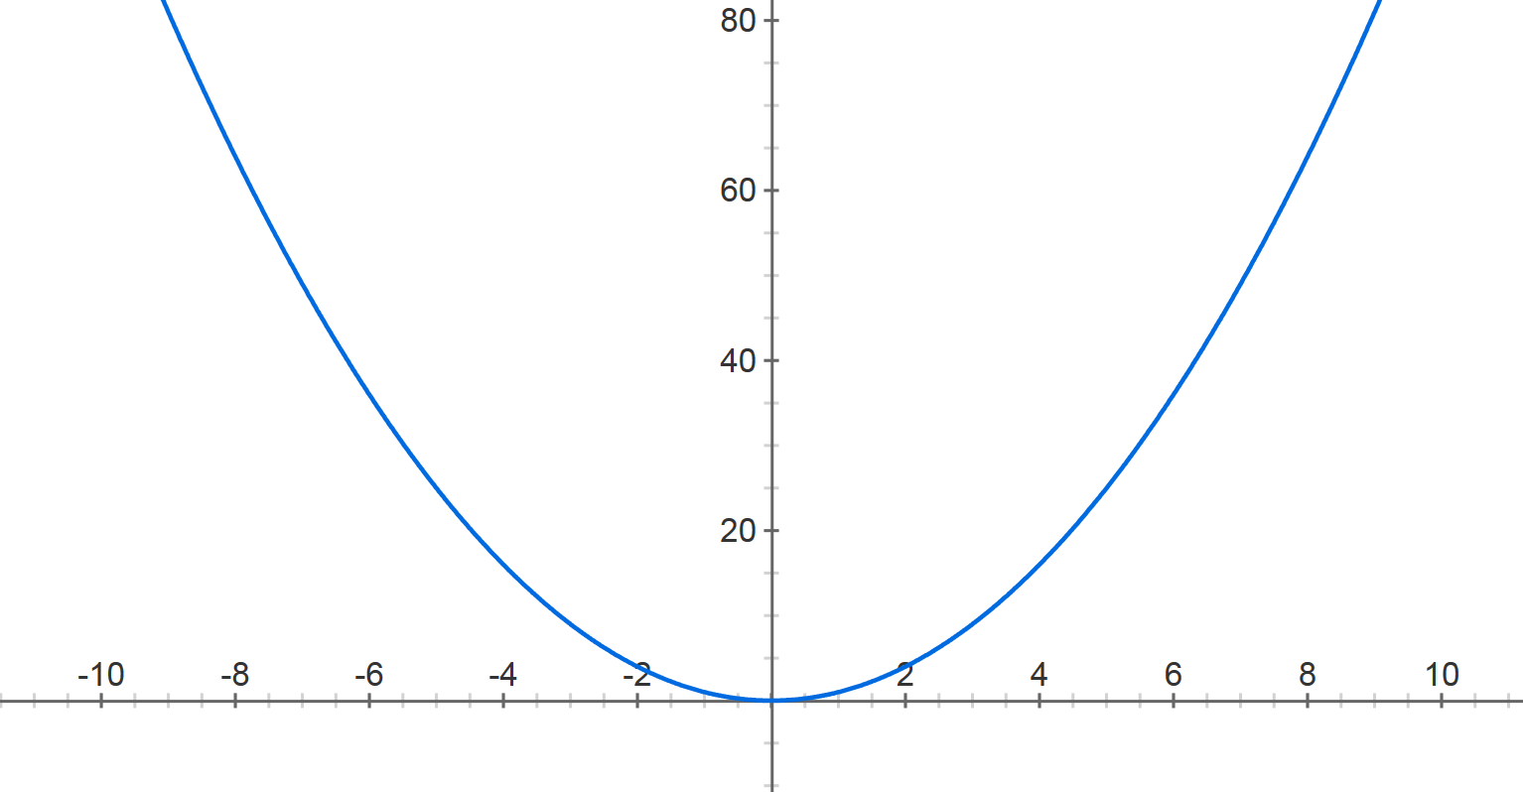
Gradient Descent
Example 1
$$E=w^{2}$$
$$E$$
$$W^{(t+1)}=W^{(t)}−α ∇E$$
$$\frac{∂E}{∂w}=2w$$
$$α=0.8$$
$$w^{(0)}=−4$$
$$w$$

Slide 29
Gradient Descent
Example 1
$$E=w^{2}$$
$$E$$
$$W^{(t+1)}=W^{(t)}−α ∇E$$
$$\frac{∂E}{∂w}=2w$$
$$α=0.8$$
$$w^{(0)}=−4$$
$$w^{(1)}=−4−0.8∗2∗(−4)$$
$$w$$

Slide 30
Gradient Descent
Example 1
$$E=w^{2}$$
$$E$$
$$W^{(t+1)}=W^{(t)}−α ∇E$$
$$\frac{∂E}{∂w}=2w$$
$$α=0.8$$
$$w^{(0)}=−4$$
$$w^{(1)}=2.4$$
$$w$$

Slide 31
Gradient Descent
Example 1
$$E=w^{2}$$
$$E$$
$$W^{(t+1)}=W^{(t)}−α ∇E$$
$$\frac{∂E}{∂w}=2w$$
$$α=0.8$$
$$w^{(0)}=−4$$
$$w^{(1)}=2.4$$
$$w^{(2)}=2.4−0.8∗2∗2.4$$
$$w$$

Slide 32
Gradient Descent
Example 1
$$E=w^{2}$$
$$E$$
$$W^{(t+1)}=W^{(t)}−α ∇E$$
$$\frac{∂E}{∂w}=2w$$
$$α=0.8$$
$$w^{(0)}=−4$$
$$w^{(1)}=2.4$$
$$w^{(2)}=−1.44$$
$$w$$

Slide 33
Gradient Descent
Example 1
$$E=w^{2}$$
$$E$$
$$W^{(t+1)}=W^{(t)}−α ∇E$$
$$\frac{∂E}{∂w}=2w$$
$$α=0.8$$
$$w^{(0)}=−4$$
$$w^{(1)}=2.4$$
$$w^{(2)}=−1.44$$
$$w^{(3)}=0.864$$
$$w^{(4)}=−0.5184$$
$$w^{(5)}=0.31104$$
$$w$$
$$w^{(30)}=−8.84296e−07$$

Slide 34
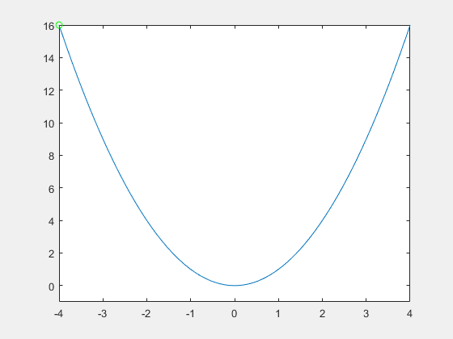
Gradient Descent
Example 2
$$α=0.9$$

Slide 35

Gradient Descent
Example 3
$$α=0.2$$

Slide 36
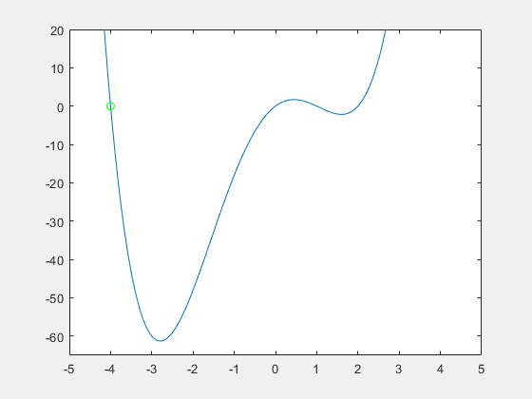
Gradient Descent
Example 4
$α$ is important

Slide 37
Gradient Descent
Example 5
$α$ is important

Slide 38
Variants of Gradient Descent
BATCH GRADIENT DESCENT
Computes gradient on the entire training set
The entire dataset to be loaded into memory for each iteration, which can be computationally expensive for large datasets
Convergence is typically stable but may be slow for large datasets
STOCHASTIC GRADIENT DESCENT
Performs parameter update for each individual training example (input-output pair) in the training set
Converges faster compared to the batch gradient descent
Convergence behaviour is usually noisy and unstable
MINI-BATCH GRADIENT DESCENT
Dividing the training set into a number of mini-batches
An improved form of stochastic gradient descent
Provides a decent trade-off between convergence efficiency and convergence stability

Slide 39
SCC.361: Artificial Intelligence
2024-2025
Week 10 – Lecture 2
Generative Adversarial Networks (GANs)
Hossein Rahmani
Prof. in Computer Vision and Machine Learning
Email: h.rahmani@lancaster.ac.uk

Slide 40
Outline
Generative Models vs. Discriminative models
Why Generative Models?
Variational Autoencoders (VAEs)
Generative Adversarial Networks (GANs)
Denoising Score Matching Models (e.g., Diffusion)
Generative Adversarial Networks (GANs)
GAN’s Architecture
How to train GANs?
Conditional GANs
Applications of GANs
Summary of main points

Slide 41
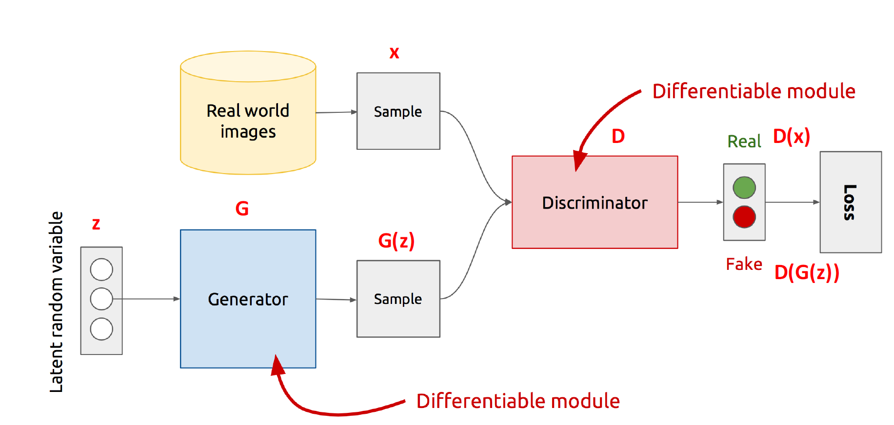
Generative Adversarial Networks
Generative
Learn a generative model
Adversarial
Trained in an adversarial setting
Network
Use Deep Neural Networks

Slide 42
Why Generative Models?
We know of discriminative models
Given an X, predict a label Y
Estimates P(Y|X)
Discriminative models have several disadvantages
Can’t model P(X), i.e. the probability of seeing a certain point
Thus, can’t sample from P(X), i.e. can’t generate new data
Generative models (in general) cope with all of above
Can model P(X)
Can generate new data

Slide 43
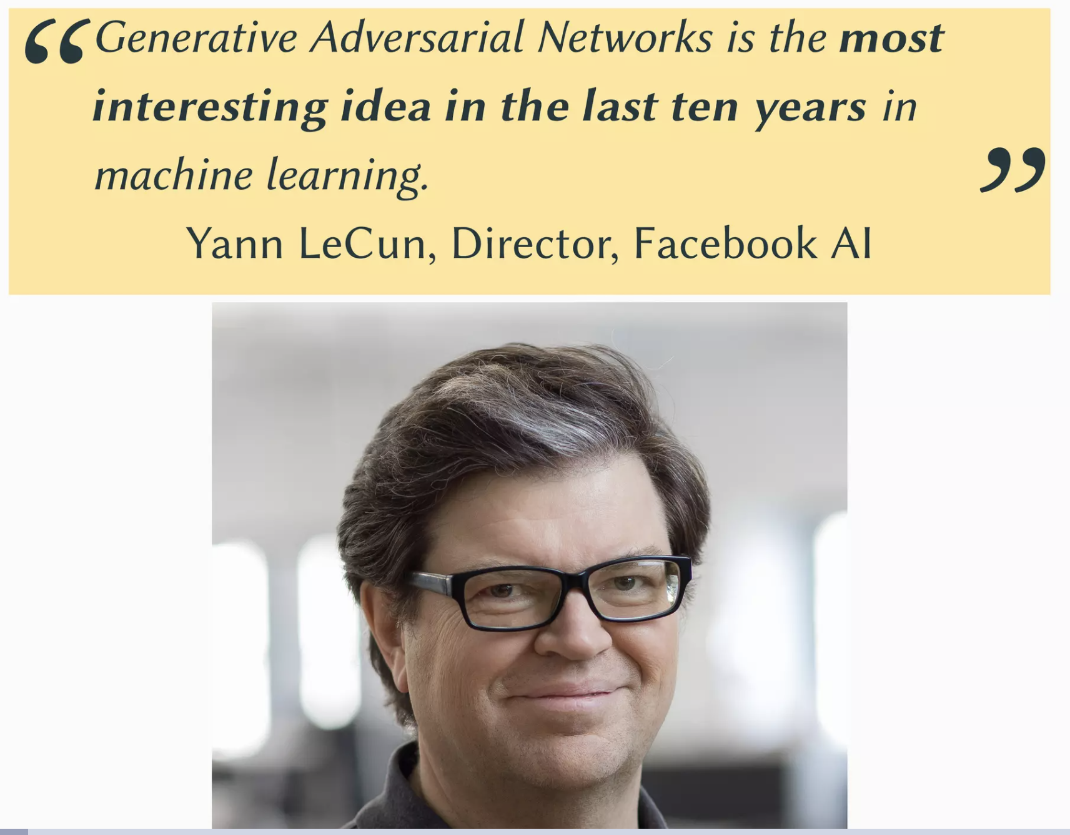
Generative Adversarial Networks

Slide 44
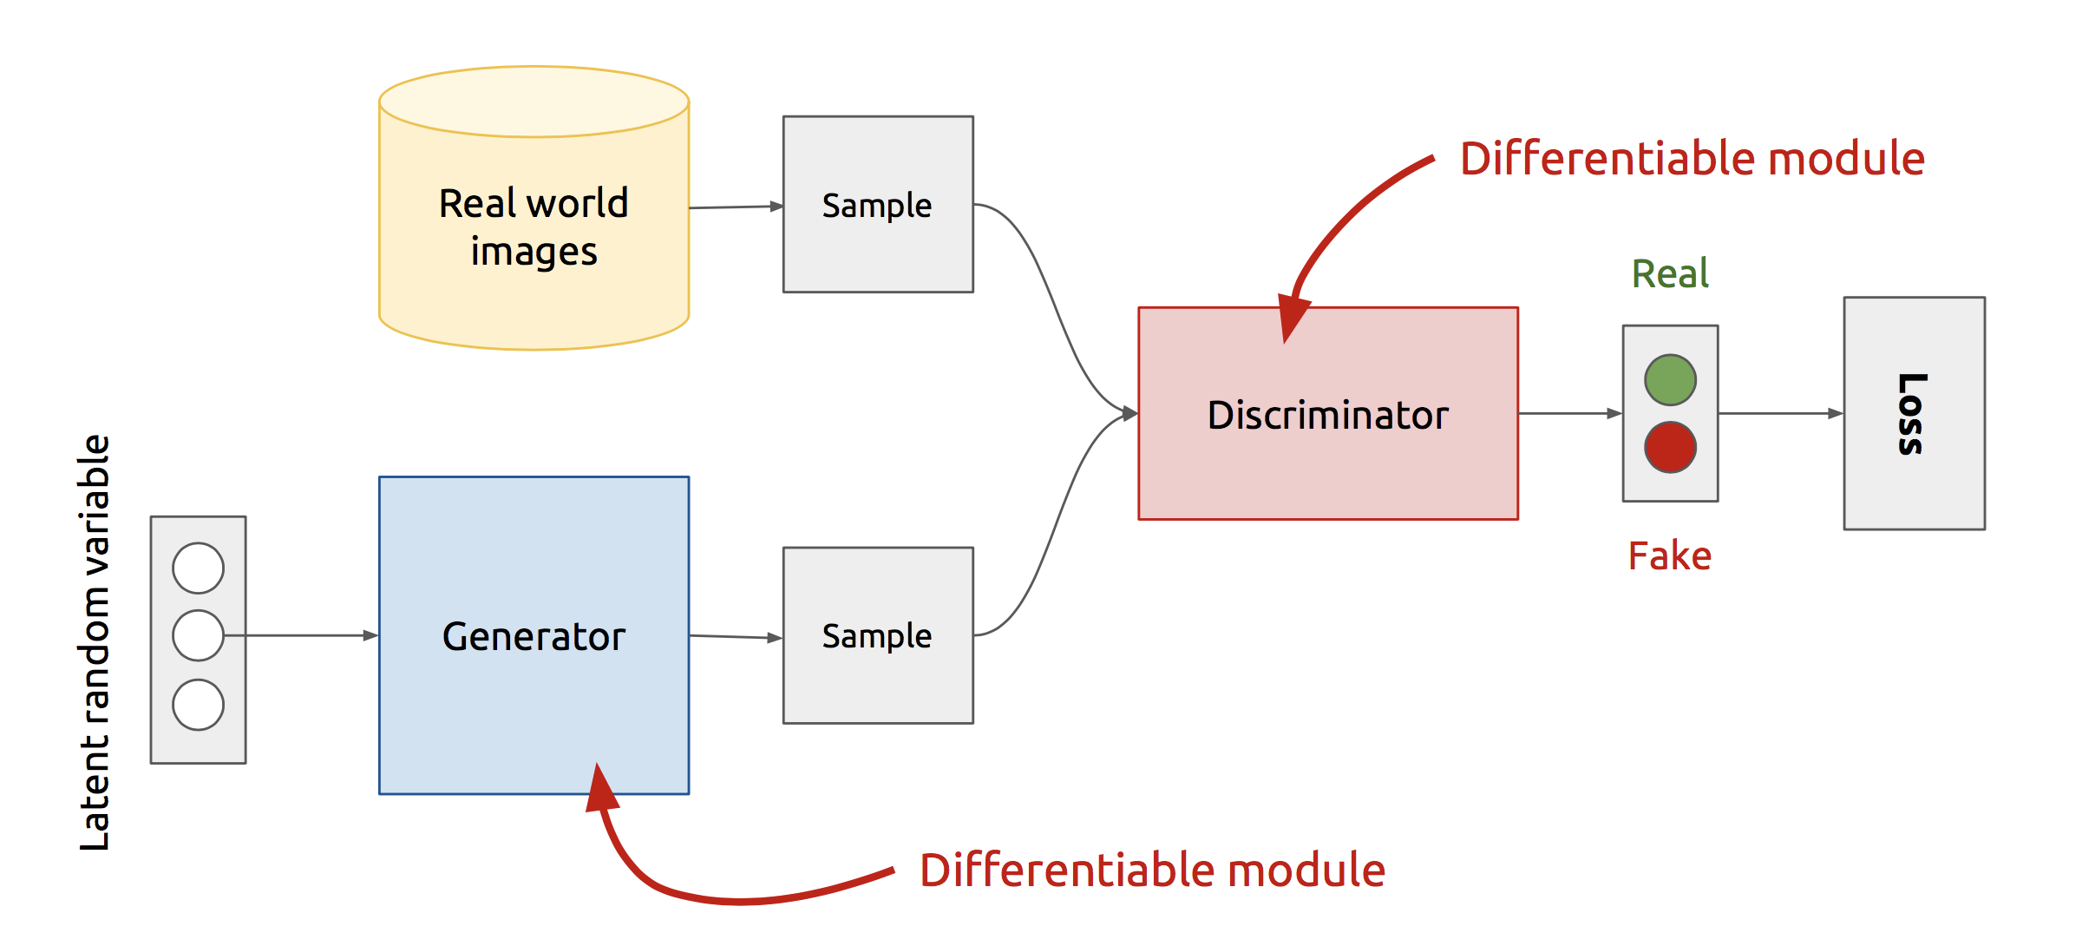
GAN’s Architecture
Z is some random noise (Gaussian/Uniform).
Z can be thought as the latent representation of the image.

Slide 45
How to train GANs?
Which network should I train first?
Discriminator D !!!
But, with what training data?
The Discriminator is a Binary classifier
The Discriminator has two class - Real and Fake.
The data for Real class is already given: TRAINING DATA
The data for Fake class? Generate from the Generator
What’s next? Train the Generator
But how? What’s our training objective?

Slide 46
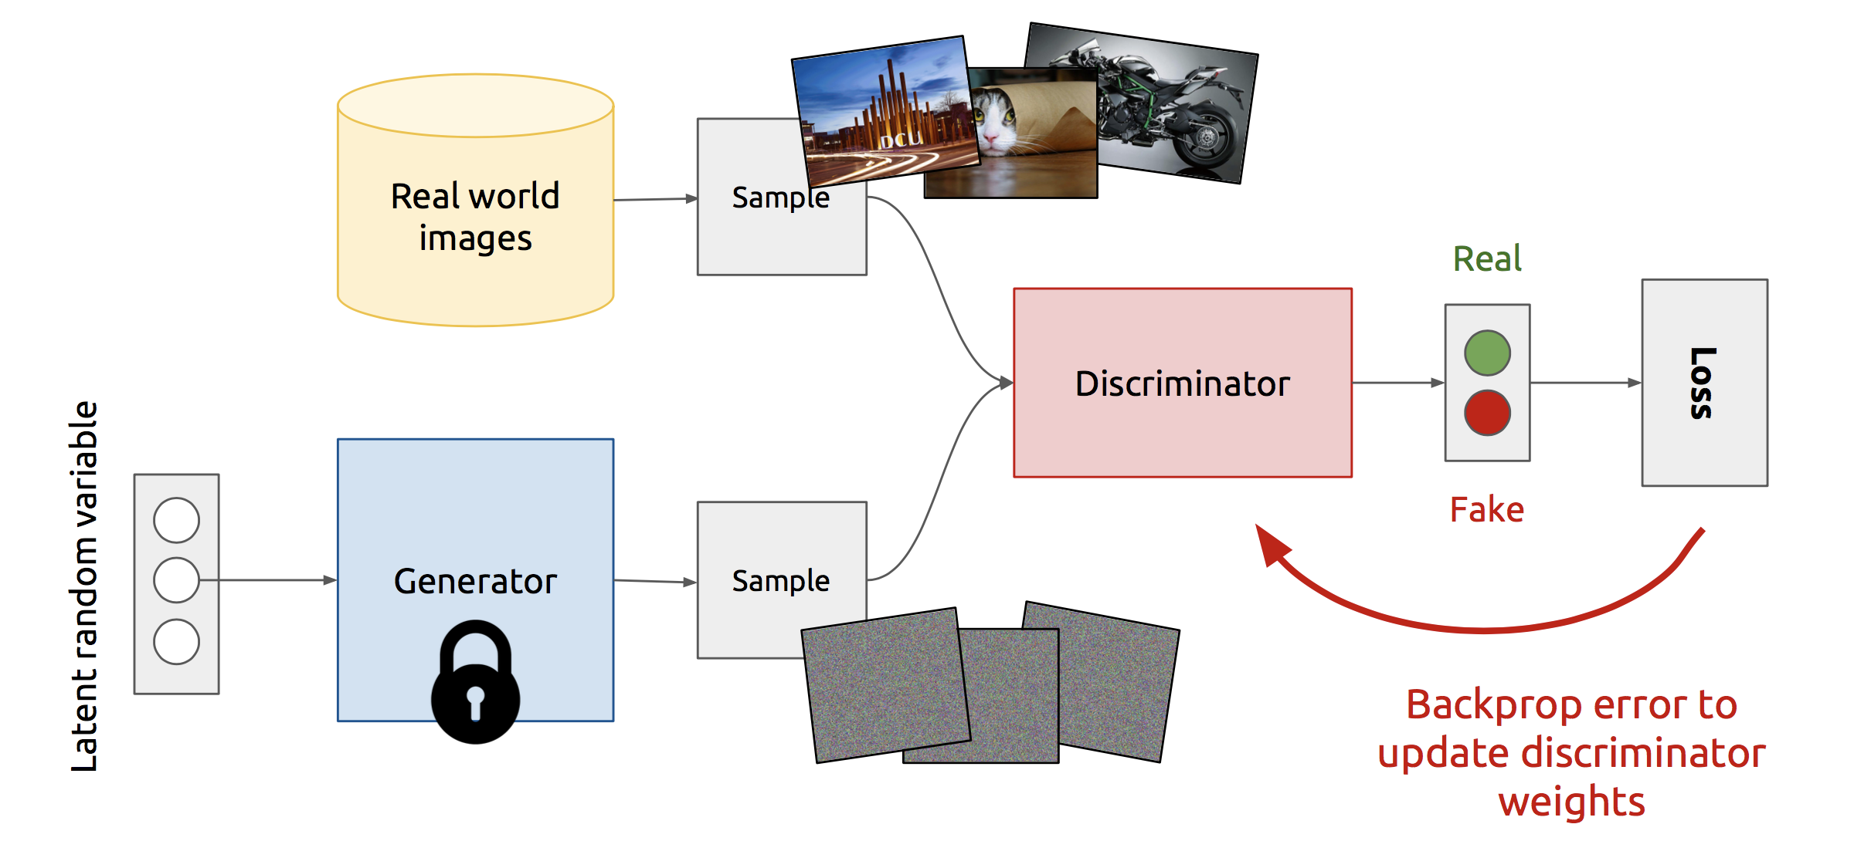
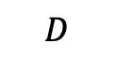
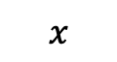
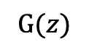
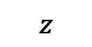
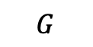
Training Discriminator
Step 1: Train the Discriminator using the current ability of the Generator
$$x$$
$$D$$
$$G$$
$$G(z)$$
$$z$$

Slide 47
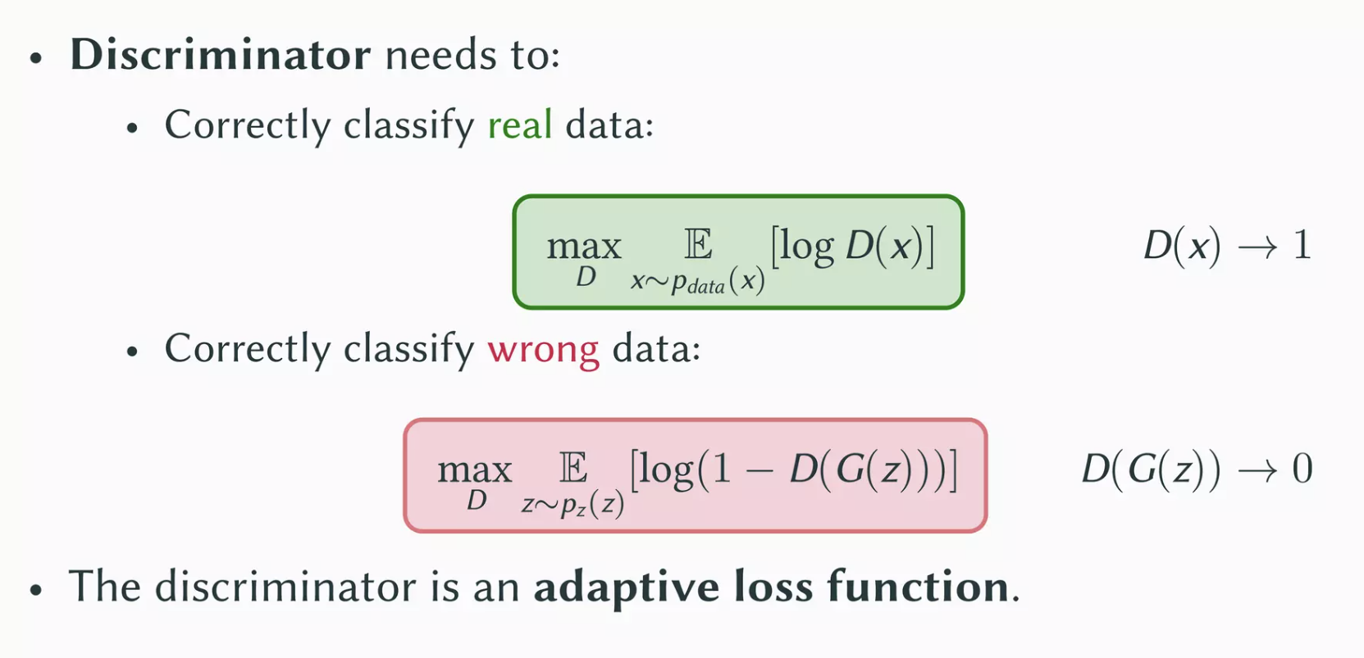
Training Discriminator

Slide 48
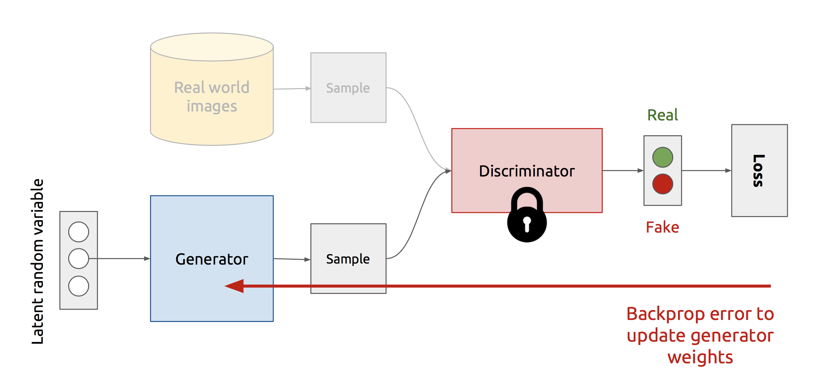
Training Generator
Step 2: Train the Generator to beat the Discriminator
$$x$$
$$D$$
$$G$$
$$G(z)$$
$$z$$

Slide 49
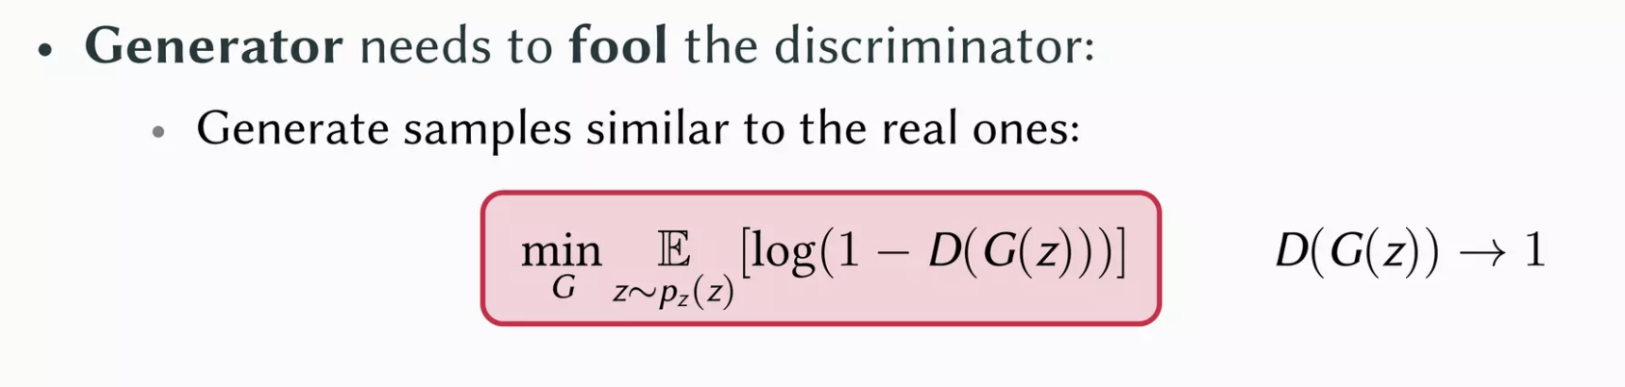
Training Generator

Slide 50
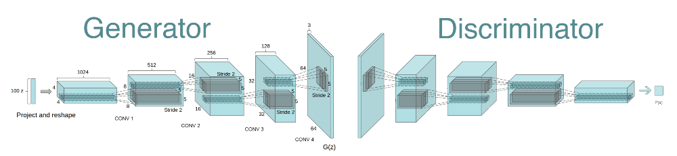
DCGAN
DCGAN (a GAN based image generator) is a direct extension of the GAN, except that it explicitly uses convolutional and convolutional-transpose layers in the discriminator and generator, respectively.

Slide 51
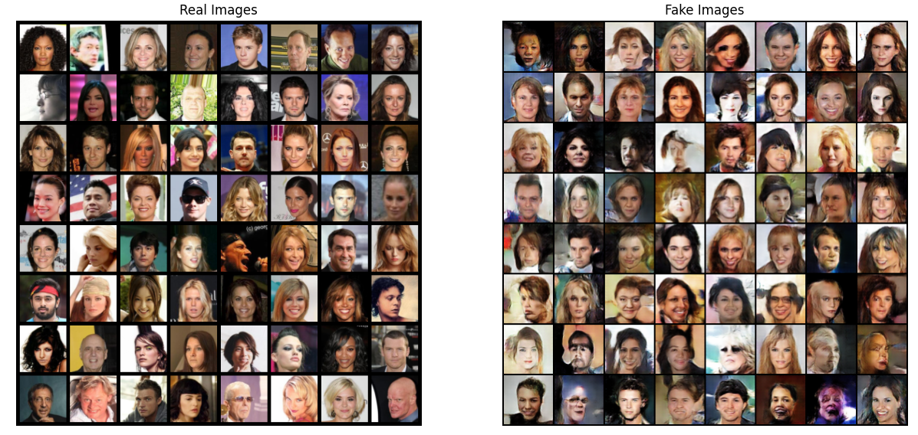
Unconditional Face Generation
We train a DCGAN model on a dataset of faces. The main objective of the model is to get a Generator Network to generate new images of fake human faces that look as realistic as possible.

Slide 52
Conditional GANs
For example, if we train a generator to generate new MNIST images (digit images), There is no control over which specific digits will be produced by the Generator.
This problem can be addressed by a variation of GAN called Conditional GAN (CGAN).
We could add an additional input layer with values of one-hot-encoded image labels.
The Generator and Discriminator both receive some additional conditioning input information. This could be the class of the current image or some other property.

Slide 53
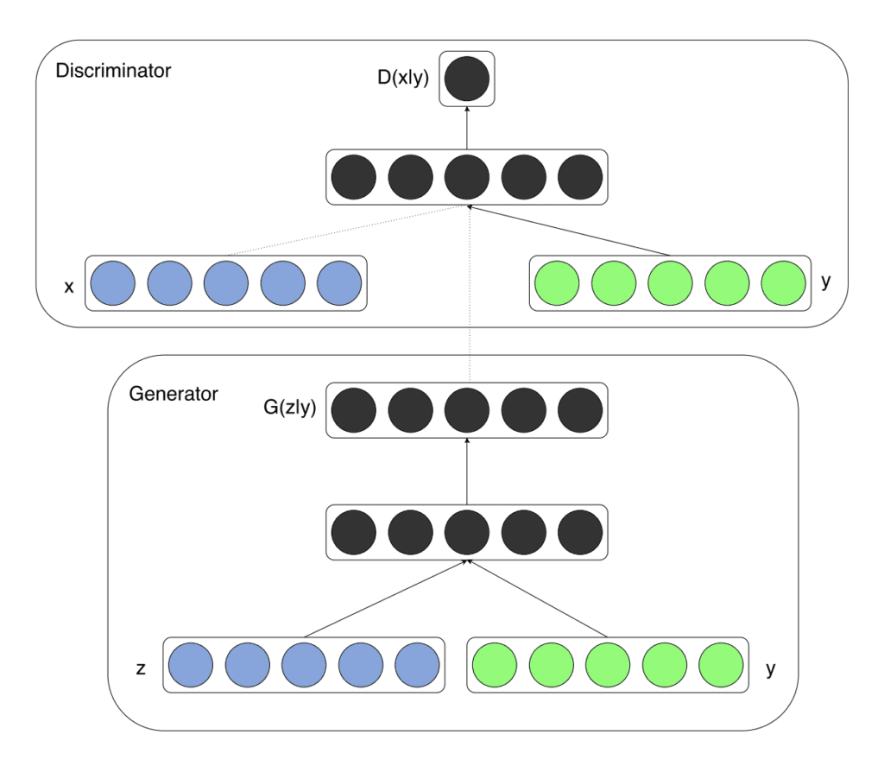
Conditional GANs
Both Generator G and Discriminator D are conditioned on extra information y. This could be the class of the current image or some other property.
In Practice: perform conditioning by feeding y into Generator G and Discriminator D

Slide 54
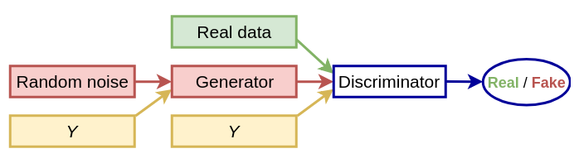
Conditional GANs
Both Generator G and Discriminator D are conditioned on extra information y. This could be the class of the current image or some other property.
In Practice: perform conditioning by feeding y into Generator G and Discriminator D

Slide 55
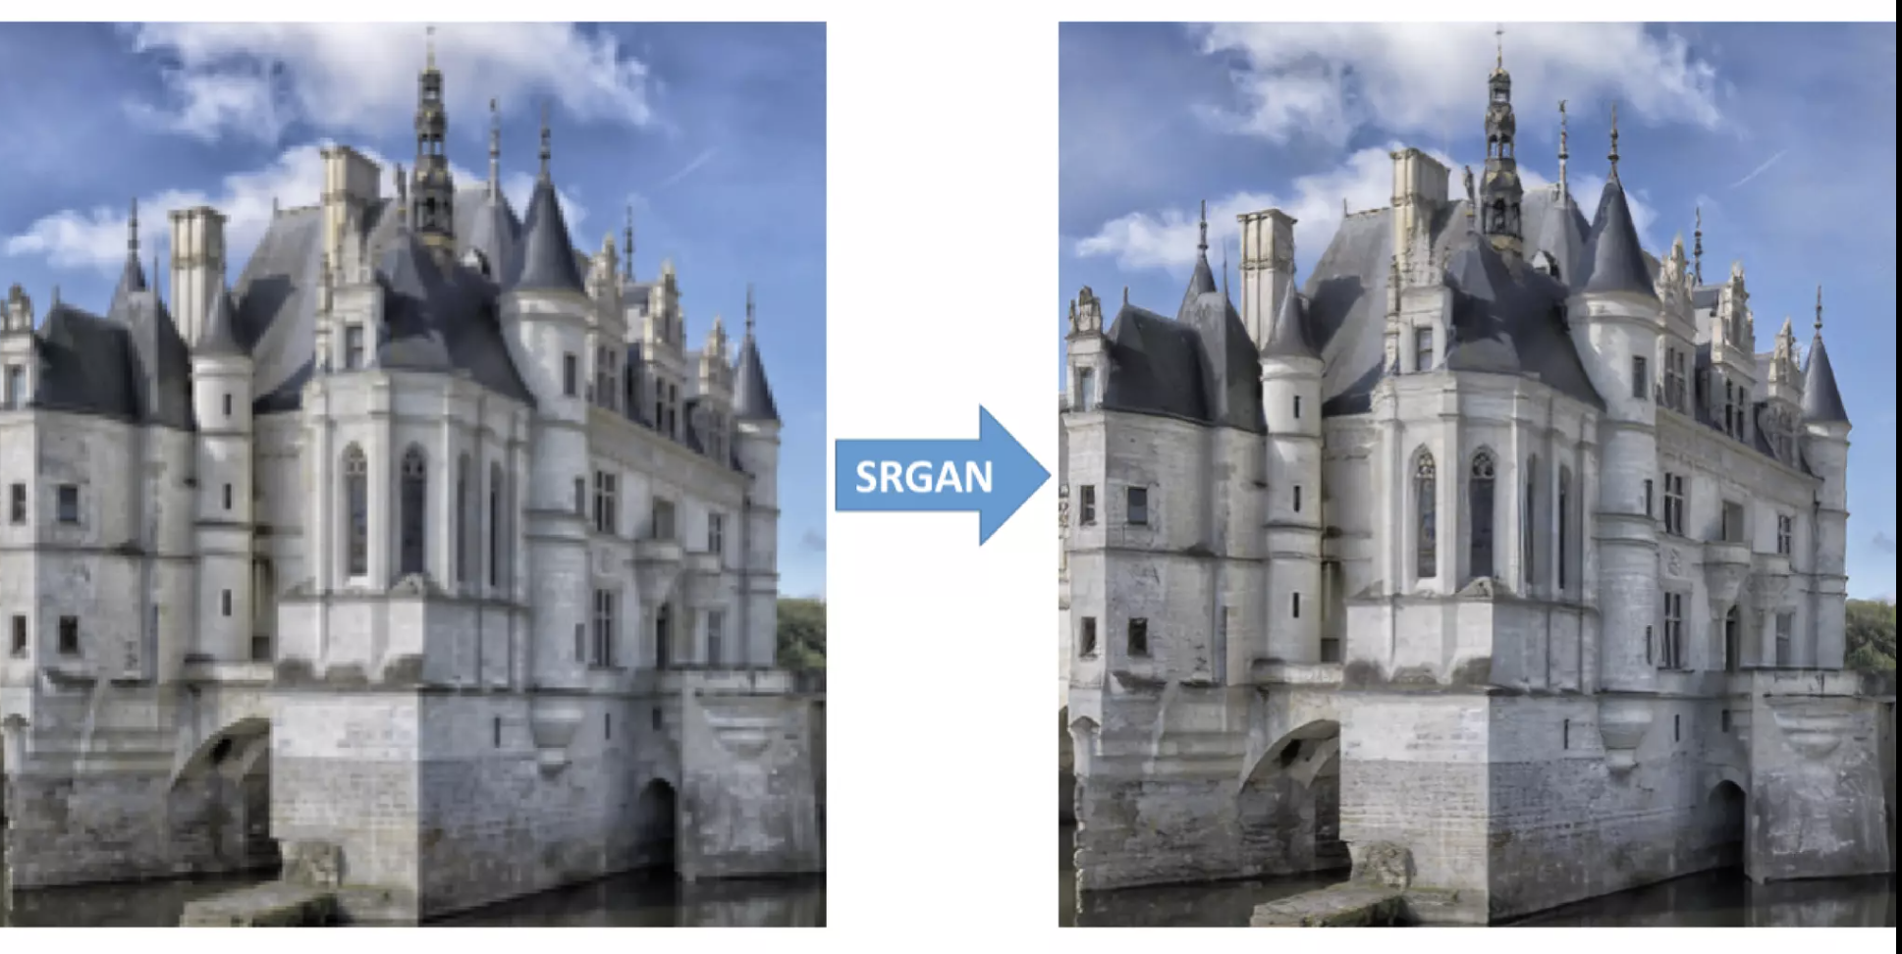
Conditional Image Super Resolution
Generating high-resolution images from low-resolution inputs.

Slide 56
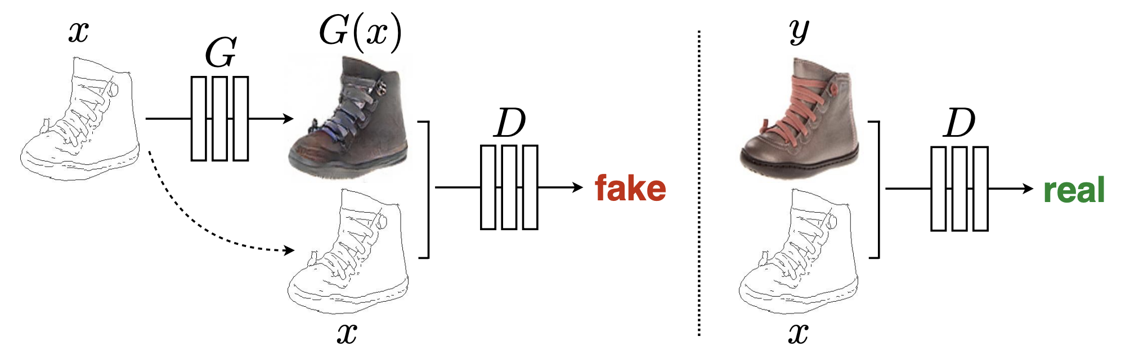
Conditional Domain Translation
Many problems in image processing, graphics, and vision involve translating an input image into a corresponding output image.

Slide 57
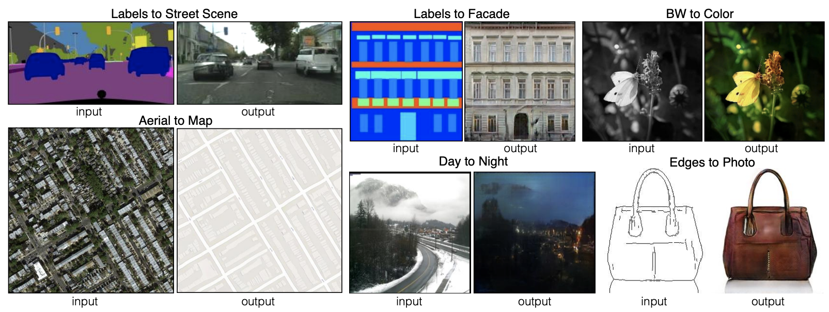
Conditional Domain Translation
Many problems in image processing, graphics, and vision involve translating an input image into a corresponding output image.

Slide 58
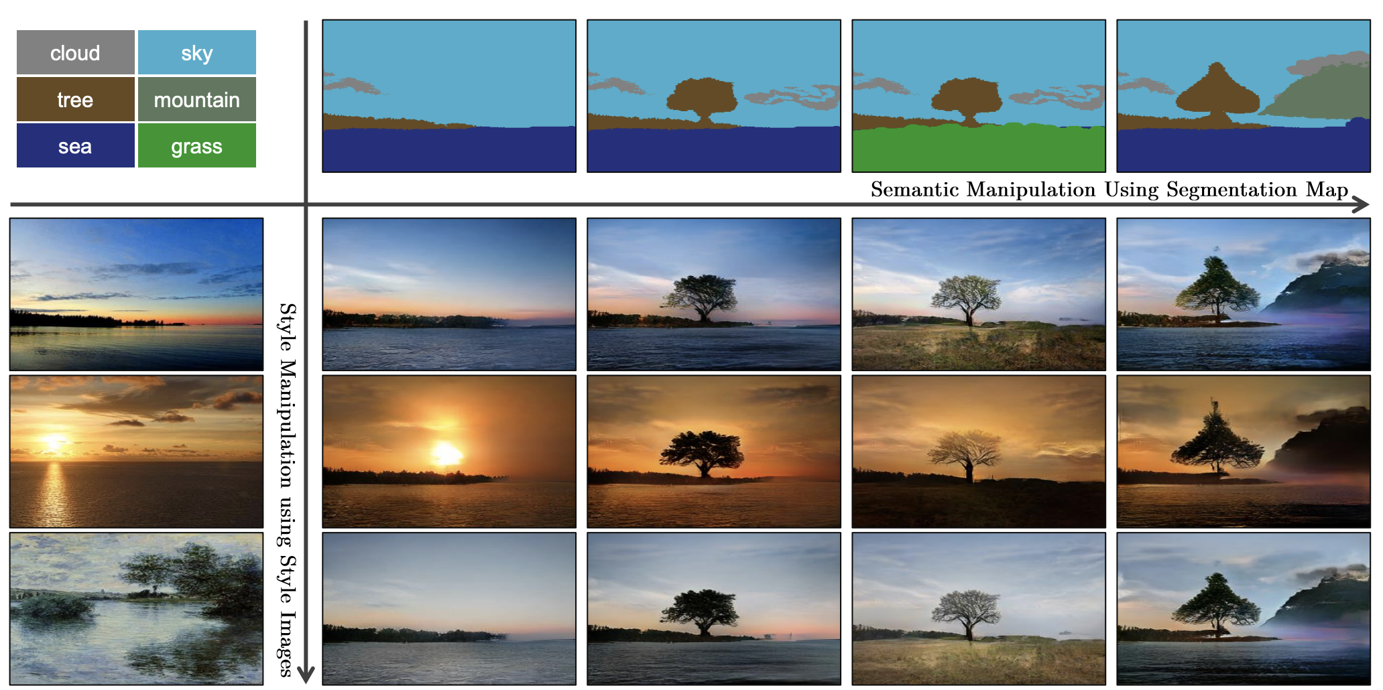
Conditional Semantic Image Synthesis
Generating images based on semantic information or high-level scene understanding.

Slide 59
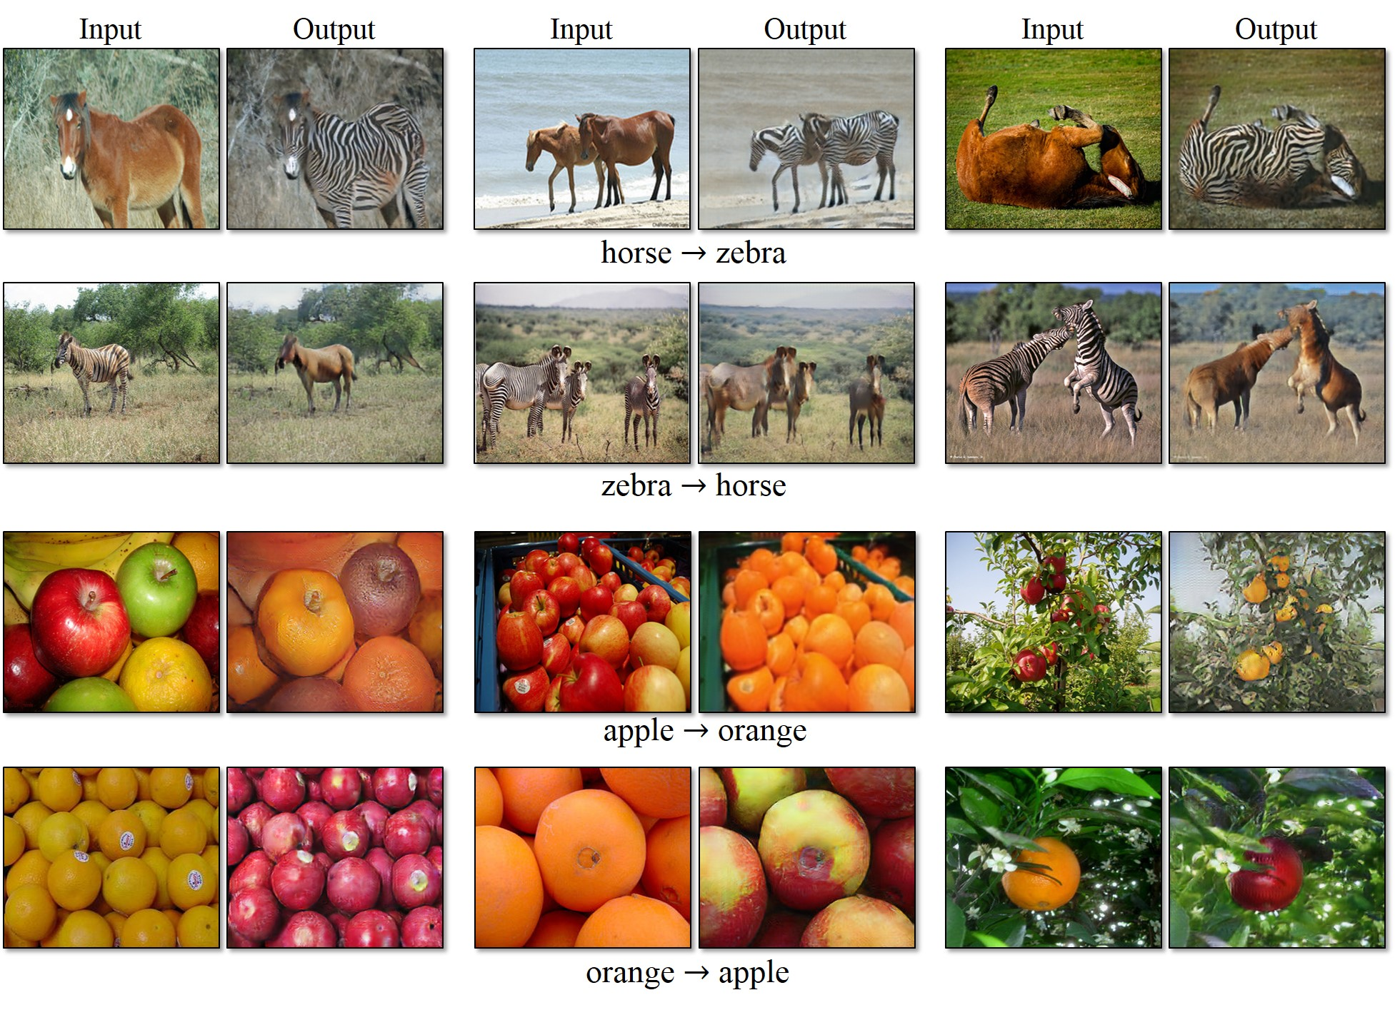
Image to Image Translation CycleGAN

Slide 60
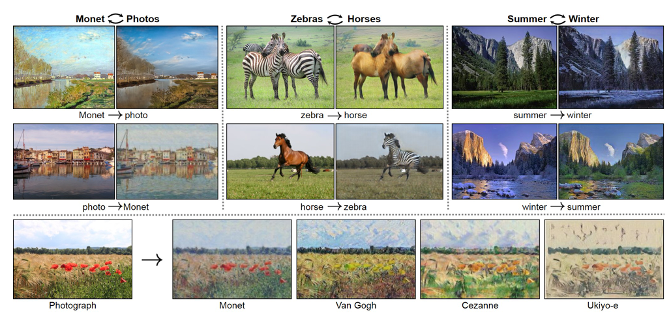
Applications of GANs
Image generation (CGAN, DCGAN)
Image translation (Cycle GAN)
Super-resolution (SRGAN, ProGAN)
Face aging (StarGAN, AgeC-GAN)
Texture synthesis (Style GAN)
Video (MoCoGAN, Pose-GAN)
Text-to-images (StackGAN, PSGAN)
Image Synthesis (BigGAN, ProGAN, SAGAN)
Object detection (Perceptual GAN)
Many others
Picture: Cycle GAN paper

